Slide 1
CSC371-Database Systems I Lecture-11(Lab) (Fall 2023)

Slide 2
Previous Lecture Review
SQL Joins
Where clause
Join & ON
INNER JOIN
ALIAS for table name
Join two tables
Join three or more tables

Slide 3
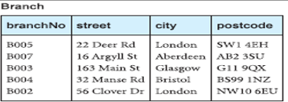
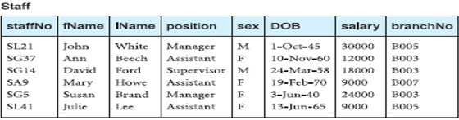
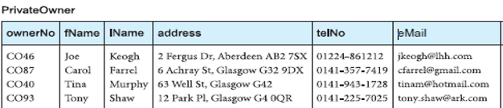
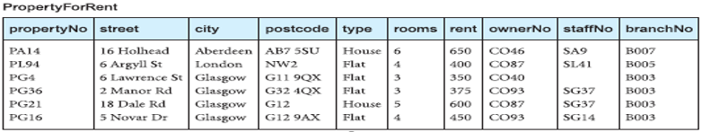

Slide 4
Agenda
SQL Joins
Outer Joins
Left Outer Join
Right Outer Join
Full Outer Join
Self Join

Slide 5
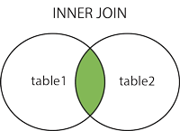
SQL INNER JOIN
The INNER JOIN keyword selects records that have matching values in both tables.
SELECT column_name(s) FROM table1 INNER JOIN table2 ON table1.column_name = table2.column_name;

Slide 6
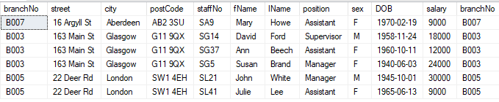
select * from branch inner join staff on branch.branchno = staff.branchno

Slide 7
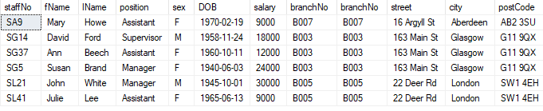
select * from staff inner join branch on branch.branchno = staff.branchno

Slide 8
Outer Joins
Left Outer Join
Right Outer Join
Full Outer Join

Slide 9
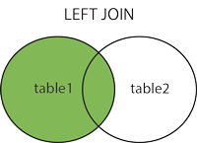
SQL LEFT OUTER JOIN
The LEFT JOIN keyword returns all records from the left table (table1), and the matched records from the right table (table2). The result is NULL from the right side, if there is no match.

Slide 10
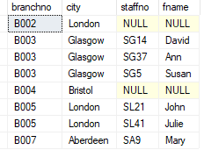
SELECT column_name(s) FROM table1 LEFT JOIN table2 ON table1.column_name = table2.column_name;
SELECT Branch.branchno, Branch.city, staff.staffno, staff.fname FROM Branch LEFT JOIN Staff ON Branch.branchno = staff.branchno
ORDER BY branch.branchno;

Slide 11
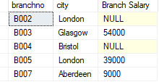
Generate a report for total salary of each branch
select branch.branchno, branch.city, sum(staff.salary) As [Branch Salary]
from branch left join staff on Branch.branchno = staff.branchno
Group by branch.branchNo,branch.city
order by branchno

Slide 12
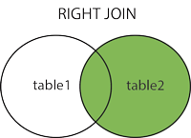
SQL RIGHT OUTER JOIN
The RIGHT JOIN keyword returns all records from the right table (table2), and the matched records from the left table (table1). The result is NULL from the left side, when there is no match.

Slide 13
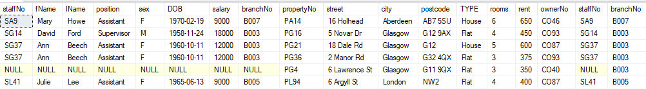
SELECT column_name(s) FROM table1 RIGHT JOIN table2 ON table1.column_name = table2.column_name;
select * from staff right join PropertyForRent on staff.staffno = PropertyForRent.staffno
SG5
SL21

Slide 14
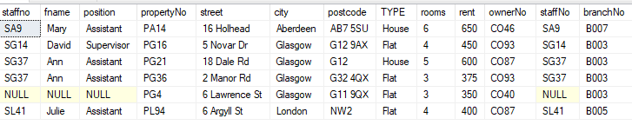
Detail of all properties with the detail of staff who assigned each property
select staff.staffno, staff.fname,staff.position, propertyforrent.*
from staff right join PropertyForRent on staff.staffno =PropertyForRent.staffno
order by propertyforrent.propertyNo

Slide 15
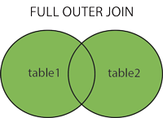
SQL FULL OUTER JOIN
The FULL OUTER JOIN keyword returns all records when there is a match in left (table1) or right (table2) table records.
Note: FULL OUTER JOIN can potentially return very large result-sets!
Tip: FULL OUTER JOIN and FULL JOIN are the same.

Slide 17
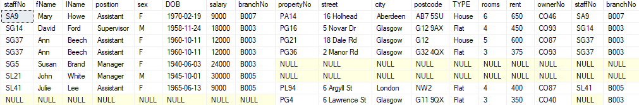
SELECT column_name(s) FROM table1 FULL OUTER JOIN table2 ON table1.column_name = table2.column_name WHERE condition;
select * from staff full join PropertyForRent on staff.staffno = PropertyForRent.staffno

Slide 18
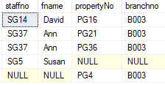
Is there any staff number who did not assign a property and there is any property which is not assigned to any staff number at branch B003
select staff.staffno, staff.fname, propertyforrent.propertyNo, PropertyForRent.branchno from staff full join PropertyForRent on staff.staffno = PropertyForRent.staffno
where propertyforrent.branchno='B003' or staff.branchno ='B003'

Slide 19

select staff.staffno, staff.fname, propertyforrent.propertyNo, PropertyForRent.branchno from staff full join PropertyForRent on staff.staffno = PropertyForRent.staffno
where propertyforrent.branchno='B003’

Slide 20
Self Join
Used when we want to join a table with the same table
SELECT column_name(s) FROM table1 T1, table1 T2 WHERE condition;

Slide 21
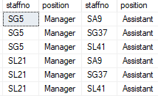
We want to pair Managers and Assistants as teams, so need data to tie them up
SELECT s1.staffno, s1.position, s2.staffno,s2.position, s1.branchno
FROM staff s1, staff s2
WHERE s1.position != s2.position
AND s1.position = 'manager’ AND s2.position = 'assistant’
order by s1.branchno

Slide 22
Reading Assignment
Equi-join
Non Equi-join
Natural Join
Semi join
Theta join

Slide 23
Summary
SQL Joins
Outer Joins
Left Outer Join
Right Outer Join
Full Outer Join
Self Join

